Slide 1
Software Engineering – I (CSC291)
Lecture 03
Agile Process Models

Slide 2
Agile SDLC’s
Speed up or bypass one or more life cycle phases
Usually less formal and reduced scope
Used for time-critical applications
Used in organizations that employ disciplined methods

Slide 3
What is Agility?
Effective response to change
Software being built, changes to the team members, changes because of new technology,
Changes of all kinds that may have an impact on the product or on project
Agility
Encourages team structures and attitudes that make communication
Rapid delivery of operational software
Deemphasizes the importance of intermediate work products
Adopts the customer as a part of the development team

Slide 4
What is Agility?
Agility can be applied to any software process by meeting following criteria
The process be designed in a way that allows the project team to adapt tasks and to streamline them
Conduct planning in a way that understands the fluidity of an agile development approach
Eliminate all but the most essential work products and keep them lean
Emphasize an incremental delivery strategy that gets working software to the customer as rapidly as feasible

Slide 5
The Principles of Agile Methods
Principle | Description
Customer involvement | Customers should be closely involved throughout the development process. Their role is provide and prioritize new system requirements and to evaluate the iterations of the system.
Incremental delivery | The software is developed in increments with the customer specifying the requirements to be included in each increment.
People not process | The skills of the development team should be recognized and exploited. Team members should be left to develop their own ways of working without prescriptive processes.
Embrace change | Expect the system requirements to change and so design the system to accommodate these changes.
Maintain simplicity | Focus on simplicity in both the software being developed and in the development process. Wherever possible, actively work to eliminate complexity from the system.

Slide 6
Agile Method Applicability
Product development where a software company is developing a small or medium-sized product for sale.
Custom system development within an organization
where there is a clear commitment from the customer to become involved in the development process
where there are not a lot of external rules and regulations
that affect the software.
Because of their focus on small, tightly-integrated teams, there are problems in scaling agile methods to large systems.

Slide 7
Problems with Agile Methods
It can be difficult to keep the interest of customers who are involved in the process.
Team members may be unsuited to the intense involvement
Prioritizing changes can be difficult where there are multiple stakeholders.
Contracts may be a problem as with other approaches to iterative development.
As requirement document is part of contract between customer and supplier
Organizations have spent year in formalizing their process so it is difficult for them to adopt informal process model defined by development teams

Slide 8
Agile Methods and Software Maintenance
Most organizations spend more on maintaining existing software than they do
on new software development.
So, if agile methods are to be successful, they have to support maintenance as well as original development.
Two key issues:
Are systems that are developed using an agile approach maintainable?
Key to implementing maintainable software is to produce high quality and well-structured code instead of documentation
Can agile methods be used effectively for evolving a system in response to customer
change requests?
Incremental delivery, design for change and maintaining simplicity all make sense when software is being changed which shows agile methods are used effectively
Problems may arise if original development team is broken up.

Slide 9
Plan-driven and agile development
Plan-driven development
A plan-driven approach to software engineering is based around separate development stages with the outputs to be produced at each of these stages planned in advance.
Not necessarily waterfall model – plan-driven, incremental development is possible
Iteration occurs within activities.
Agile development
Specification, design, implementation and testing are inter-leaved
Outputs from the development process are decided through a process of negotiation during the software development process.

Slide 10
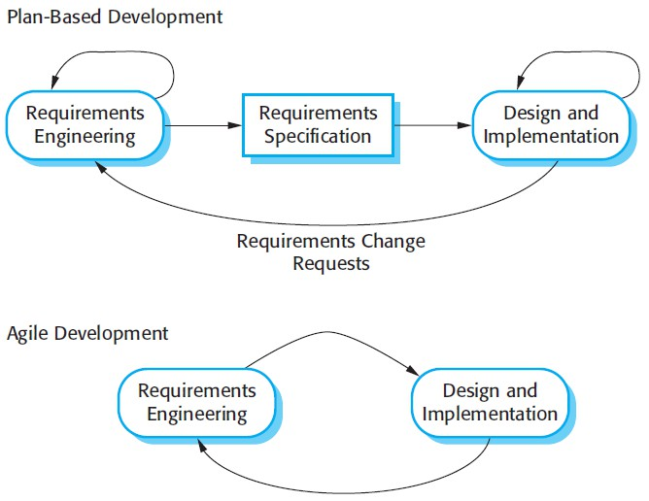
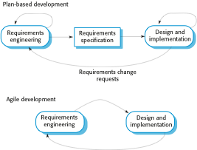
Plan-driven and Agile specification

Slide 11
Agile vs. Plan-driven Methods
Agile methods | Plan-driven methods
Low criticality | High criticality
Senior developers | Junior developers
Requirements change often | Requirements do not change often
Small number of developers | Large number of developers
Culture that responds to change | Culture that demands order

Slide 12
Agile Methods
Well-known agile software development methods and/or process frameworks include:
Rapid Application Development (RAD)
Rational Unify Process (RUP)
Extreme programming (XP)
Scrum
Test Driven Development (TDD)
Feature Driven Development (FDD)
Dynamic systems development method (DSDM)
Agile Unified Process (AUP)
Adaptive Software Development (ASD)
Agile Modeling
Crystal Clear

Slide 13
Extreme Programming (XP)

Slide 14
Extreme Programming - XP
For small-to-medium-sized teams developing software with vague or rapidly changing requirements
Coding is the key activity throughout a software project
Communication among teammates is done with code
Life cycle and behavior of complex objects defined in test cases – again in code

Slide 15
Extreme Programming
Perhaps the best-known and most widely used agile method.
Extreme Programming (XP) takes an ‘extreme’ approach to iterative development.
New versions may be built several times per day;
Increments are delivered to customers every 2 weeks;
All tests must be run for every build and the build is only accepted if tests run successfully.

Slide 16
XP and agile principles
Incremental development is supported through small, frequent system releases.
Requirements are based on simple customer stories or scenarios
•
Customer involvement means full-time customer engagement with
the team.
•
Responsible for defining acceptance tests for the system
People, not process, through pair programming, collective ownership and a process that avoids long working hours.
Change supported through regular system releases.
Maintaining simplicity through constant refactoring of code.

Slide 17
XP Practices (1-6)
Planning game – determine scope of the next release by combining business priorities and technical estimates
Small releases – put a simple system into production, then release new versions in very short cycle
Metaphor – all development is guided by a simple shared story of how the whole system works
Simple design – system is designed as simply as possible (extra complexity removed as soon as found)
Testing – programmers continuously write unit tests; customers write tests for features
Refactoring – programmers continuously restructure the system without changing its behavior to remove duplication and simplify

Slide 18
XP Practices (7 – 12)
Pair-programming -- all production code is written with two programmers at one machine
Collective ownership – anyone can change any code anywhere in the system at any time.
Continuous integration – integrate and build the system many times a day – every time a task is completed.
40-hour week – work no more than 40 hours a week as a rule
On-site customer – a user is on the team and available full-time to answer questions
Coding standards – programmers write all code in accordance with rules emphasizing communication through the code

Slide 19
Extreme programming practices [1/2]
Principle or practice | Description
Incremental planning | Requirements are recorded on story cards and the stories to be included in a release are determined by the time available and their relative priority. The developers break these stories into development ‘Tasks’.
Small releases | The minimal useful set of functionality that provides business value is developed first. Releases of the system are frequent and incrementally add functionality to the first release.
Simple design | Enough design is carried out to meet the current requirements and no more.
Test-first development | An automated unit test framework is used to write tests for a new piece of functionality before that functionality itself is implemented.
Refactoring Software En | All developers are expected to refactor the code continuously as soon as possible code improvements are found. This keeps the code simple and maintainable. gineering Concepts-CSC291-FALL-2024 Dr. Tehseen Riaz Abbasi

Slide 20
Extreme programming practices [2/2]
Pair programming | Developers work in pairs, checking each other’s work and providing the support to always do a good job.
Collective ownership | The pairs of developers work on all areas of the system, so that no islands of expertise develop and all the developers take responsibility for all of the code. Anyone can change anything.
Continuous integration | As soon as the work on a task is complete, it is integrated into the whole system. After any such integration, all the unit tests in the system must pass.
Sustainable pace | Large amounts of overtime are not considered acceptable as the net effect is often to reduce code quality and medium term productivity
On-site customer | A representative of the end-user of the system (the customer) should be available full time for the use of the XP team. In an extreme programming process, the customer is a member of the development team and is responsible for bringing system requirements to the team for implementation.

Slide 21
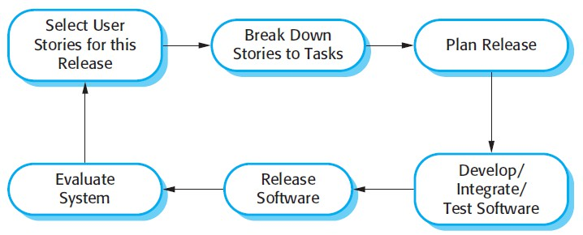
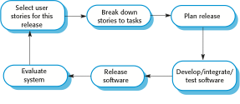
The Extreme Programming Release Cycle

Slide 22
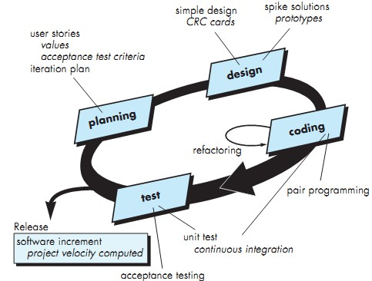
Extreme Programming

Slide 23
Planning
In XP, a customer or user is part of the XP team and is responsible for making decisions on requirements.
User requirements are expressed as scenarios or user stories.
These are written on cards
The development team break them down into implementation tasks.
These tasks are the basis of schedule and cost estimates.
The customer chooses the stories for inclusion in the next release based on their priorities and the schedule estimates.

Slide 24
Design
Provides implementation guidance for a story as it is written
XP encourages the use of CRC (class-responsibility- collaborator) cards
Identify and organize the object oriented classes that are relevant to the current software increment
If a difficult design problem is encountered
Immediately creation of an operational prototype of that portion of the design called Spike
Intent is to lower risk when true implementation starts
Encourage refactoring

Slide 25
Refactoring
Programming team look for possible software improvements and make these improvements even where there is no immediate need for them.
This improves the understandability of the software and so reduces the need for documentation.
Changes are easier to make because the code is well-structured and clear.
However, some changes requires architecture refactoring and this is much more expensive.

Slide 26
Examples of refactoring
Re-organization of a class hierarchy to remove duplicate code.
Tidying up and renaming attributes and methods to make them easier to understand.
The replacement of inline code with calls to methods that have been included in a program library.
Eclipse include tools for refactoring which simplify the process of finding dependencies between code sections and making global code modifications
In principle, software is easy to understand and change as new stories are implemented

Slide 27
Coding
After creating simple design team move to developing tests instead of coding
Develops unit test; the developer is better able to focus on what must be implemented to pass the test
•
A key concept during the coding activity is pair programming

Slide 28

Pair Programming
Programmers sit together at the same workstation to develop the software.
Pairs are created dynamically so that all team members work with each other during the development process.
The sharing of knowledge between pairs reduces the overall risks to a project when team members leave.
A pair working together is more efficient than 2 programmers working separately.

Slide 29
Advantages of pair programming
It supports the idea of collective ownership and responsibility for the system.
It acts as an informal review process because each line of code is looked at by at least two people.
•
It helps support refactoring, which is a process of software
improvement.

Slide 30
🞂Testing in XP
XP testing features:
Test-first development.
Incremental test development from scenarios.
User involvement in test development and validation.
Automated test are used to run all component tests each time that a new release is built.

Slide 31
Test-first development
•
Writing tests before code clarifies the requirements to be
implemented.
Ambiguities have to clarify before actual implementation
Tests are written as programs so that they can be executed automatically. The test includes a check that it has executed correctly.
Usually relies on a testing framework such as Junit.
All previous and new tests are run automatically when new functionality is added, thus checking that the new functionality has not introduced errors.

Slide 32
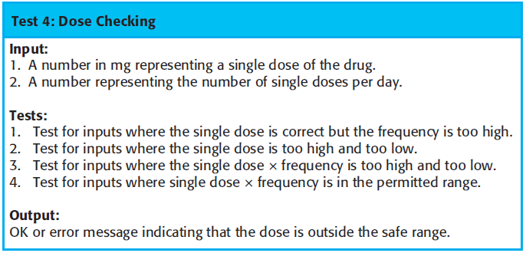
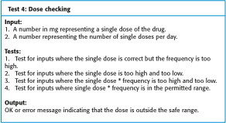
Test case description for dose checking

Slide 33
​ Scrum

Slide 34
🞂​ SCRUM
What is Scrum?
‘SCRUM’ originally derives from a strategy in the game of rugby where it denotes “getting an out of play ball back into the game” with teamwork.
SCRUM enables OO through advanced iterative, incremental development within a controlled environment. It allows organizations to build the best possible OO systems possible.
SCRUM is one of many different types of Agile Software Development Frameworks that you can use in the real world to deliver working software. It is all about people and not technological
•
SCRUM is an Agile process framework that allows organizations to continuously
direct the project toward early delivery of real business value through the frequent
and regular delivery of high quality software.

Slide 35
🞂​ Scrum
The Scrum approach is a general agile method but its focus is on managing iterative development
There are three phases in Scrum.
Outline planning phase where you establish the general objectives for the project and design the software architecture.
This is followed by a series of sprint cycles, where each cycle develops an increment of the system.
The project closure phase wraps up the project, completes required documentation
such as user manuals and assesses the lessons learned from the project.

Slide 36
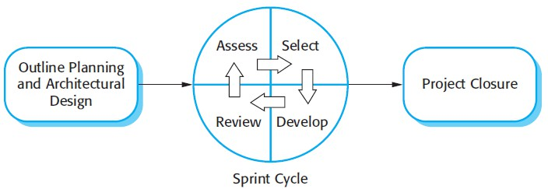
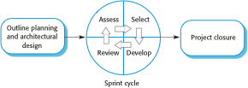
🞂​ The Scrum Process

Slide 37
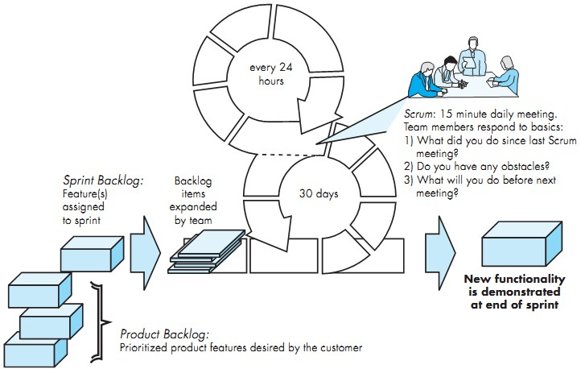
🞂​ The Scrum Process

Slide 38
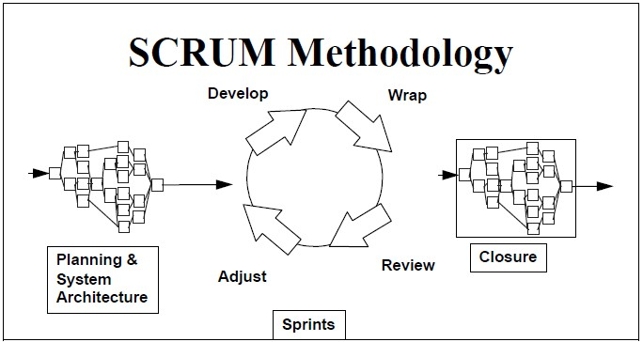
🞂​ The Scrum Process

Slide 39
🞂​ The Sprint cycle
Sprints are fixed length, normally 2–4 weeks. They correspond to the development of a release of the system in XP.
The Assess Phase
Product backlog is reviewed, and priorities and risks are assigned
Customer is involved to introduce new requirements or tasks at beginning of each sprint
The Selection Phase
Involves all of the project team who work with the customer to select the features and functionality to be developed during the sprint.

Slide 40
🞂​ The Sprint cycle
The Develop Phase
The team organize themselves to develop the software.
The team is isolated from the customer and the organization
All communication is channelled through the so-called ‘Scrum master’.
The role of the Scrum master is to protect the development team from external distractions.
The Review Phase
At the end of the sprint, the work done is reviewed and presented to stakeholders.
The next sprint cycle then begins.

Slide 41
🞂​ INTRODUCTION TO TERMS
Scrum Roles
Product Owner
Scrum Master
Scrum Team
Sprint
Daily Scrum
Product Backlog
Sprint Backlog
Scrum Meeting Rules
Software Engineering Concepts-CSC291-FALL-2024
Abbasi
Dr. Tehseen Riaz

Slide 42
🞂​ Teamwork in Daily Scrum
The whole team attends short daily meetings
What did you do since the last team meeting?
What obstacles are you encountering?
What do you plan to accomplish by the next team meeting?
This means that everyone on the team knows what is going on and, if problems arise, can re-plan short term work to cope with them.

Slide 43
🞂​ Roles and Responsibilities
Scrum Master (a facilitator who arranges)
Daily meetings, tracks the backlog of work to be done, records decisions,
measures progress against the backlog and communicates with customers and management outside of the team.
Product Owner
Responsible for project, managing, controlling and making visible
Product Backlog list
Makes final decisions of the tasks related to product Backlog
Scrum Team
It is project team
Organize itself in order to achieve the goals of each Sprint
Involved in effort estimation, creating Sprint Backlog, reviewing Product Backlog list

Slide 44
🞂​ Roles and Responsibilities
Customer
Participate in tasks related to product Backlog items
Management
In charge of final decision making
Participate in setting of goals and requirements
E.g. management is involved in selecting Product Owner

Slide 45
🞂​ Scrum benefits
Rising and Janoff (2000) discuss its advantages as follows
The product is broken down into a set of manageable and understandable chunks.
The whole team have visibility of everything and consequently team communication is improved.
Customers see on-time delivery of increments and gain feedback on how the product works.
Trust between customers and developers is established and a positive culture is created in which everyone expects the project to succeed.

Slide 46
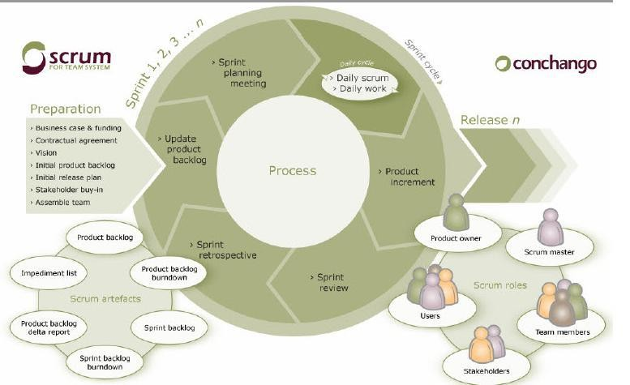
🞂​ SCRUM

Slide 47
🞂​ SCRUM’S BENEFITS/ CHARACTERISTICS
Rising and Janoff (2000) discuss its advantages as follows
The product is broken down into a set of manageable and understandable chunks.
The whole team have visibility of everything and consequently team communication is improved.
Customers see on-time delivery of increments and gain feedback on how the product works.
Trust between customers and developers is established and a positive culture is created in which everyone expects the project to succeed.
It enables project to proceed systematically
Constant testing and documentation
A deliverable product is always ready
Frequent demonstrations for early feedback from stakeholders
Team spirit
Sense off accomplishment
Quality off product

Slide 48
🞂​ WHY USE SCRUM?
Advantages
Productivity increases
Continuous improvement
Leverages the chaos
Disadvantages
Scrum requires constant monitoring both quantitatively and qualitatively
People are resistant to change
Costly

Slide 49
🞂​ CONCLUSION
Scrum is many things. Scrum is a management process Scrum accepts the empirical nature of software development as a given, working within those constraints to enable the team to deliver as much business value as possible as quickly as possible..

Slide 50
🞂​ Conclusions
Different life-cycle models
Each with its own strengths
Each with its own weaknesses
Criteria for deciding on a model include:
The organization
Its management
Skills of the employees
The nature of the product
Best suggestion
“Mix-and-match” life-cycle model

Slide 51

THANK YOU

Slide 52

THANK YOU

